Slide 1


Slide 2
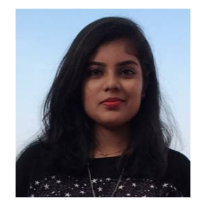
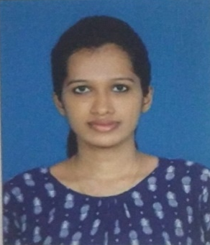
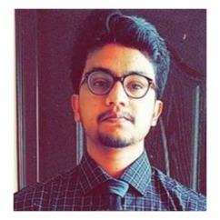
Project Highlights
Project Name : Traffic Light management system
Team Size : 3
Team Members Details (Professional Stamp Size Photo with few lines of individual briefing
Deeksha P
PS#99002664
2009MYSEMB01
BE in Electronics and Communication
Shwetha B
PS#99002499
2009MYSEMB01
BE in Electronics and Communication
Anuj Bharadwaj
PS#99002642
2009MYSEMB01
BE in Electronics and Instrumentation

Slide 3

Project Video Snippet

Slide 4
Future development that can be implemented further
Detecting Emergency vehicle by using IR sensor network
Automatic tracking of traffic laws defaulters
Automatic generation of E- challan
Implementation of traffic light management at night using thermal sensors
Traffic data update on traffic department website

Slide 5

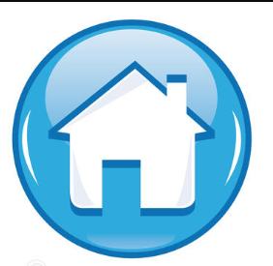
Thank You !

